Slide 1
DESIGN (ANTY-)PATTERNS
The package “java.lang.ref”
Peter Prazenica
9.5.2019

Slide 2
The Package java.lang.ref
Reference
SoftReference (extends Reference)
WeakReference (extends Reference)
PhantomReference (extends Reference)
ReferenceQueue
FinalReference (extends Reference)
Finalizer (extends FinalReference)
FinalizerHistogram
The FinalReference, Finalizer, FinalizerHistogram classes are visible in the package, and the other are all public and can be used directly in the application

Slide 3
Four Distinct Forms of References
Strong Reference - never gets collected
Soft Reference - gets collected only if the JVM absolutely needs the memory. This makes them excellent for implementing object cache's.
Weak Reference – gets collected only if no other object references it except the weak references. This makes them perfect for keeping meta data about a particular object for the life time of the object.
Phantom Reference – a safer alternative to the finalize() method, it cannot resurrect the object by creating a new strong reference

Slide 4
Four Distinct Forms of References
Strong Reference
Integer prime = 1;
Soft Reference
Integer prime = 1;
SoftReference<Integer> soft = new SoftReference<>(prime);
prime = null;
Weak Reference
Integer prime = 1;
WeakReference<Integer> weak = new WeakReference<>(prime);
prime = null;
Phantom Reference

Slide 5
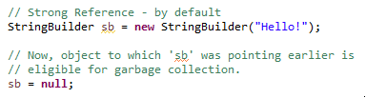
Strong References
This is a default type/class of Reference Object
Any object which has an active strong reference are not eligible for garbage collection
The object is garbage collected only when the variable which was strongly referenced points to null

Slide 6
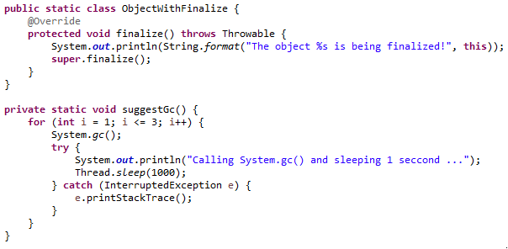
Strong References – Example No. 1

Slide 7
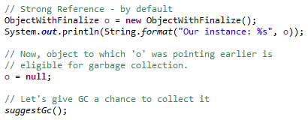
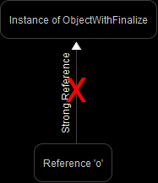
Strong References – Example No. 1
Our instance: other.references.StrongReferenceExample$ObjectWithFinalize@15db9742
Calling System.gc() and sleeping 1 second ...
The object other.references.StrongReferenceExample$ObjectWithFinalize@15db9742 is being finalized!
Calling System.gc() and sleeping 1 second ...
Calling System.gc() and sleeping 1 second ...

Slide 8
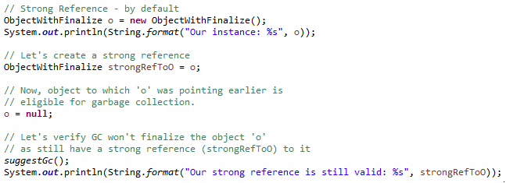
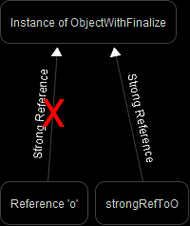
Strong References – Example No. 2
Our instance: other.references.StrongReferenceExample2$ObjectWithFinalize@15db9742
Calling System.gc() and sleeping 1 second ...
Calling System.gc() and sleeping 1 second ...
Calling System.gc() and sleeping 1 second ...
Our strong reference is still valid: other.references.StrongReferenceExample2$ObjectWithFinalize@15db9742

Slide 9
Weak References
To create such references java.lang.ref.WeakReference class is used.
Example: WeakReference<Integer> weakRefToInteger = new WeakReference<Integer>(i);
If JVM detects an object with only weak references (i.e. no strong or soft references linked to this object), it will be marked for garbage collection.
It does not prevent the referent from being made finalizable, finalized, and then reclaimed.
It is often used to implement canonicalizing mappings or to fix the Lapsed Listener problem.

Slide 10
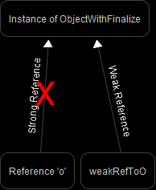
Weak References – Example

Slide 11
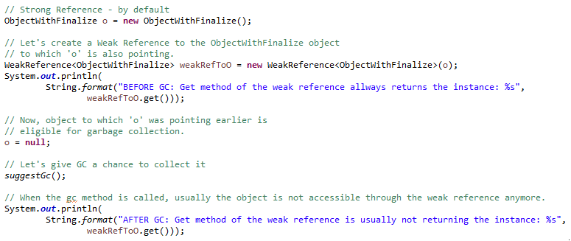
Weak References – Example

Slide 12
Weak References – Example
BEFORE GC: Get method of the weak reference allways returns the instance: other.references.WeakReferenceExample$ObjectWithFinalize@15db9742
Calling System.gc() and sleeping 1 second ...
The object other.references.WeakReferenceExample$ObjectWithFinalize@15db9742 is being finalized!
Calling System.gc() and sleeping 1 second ...
Calling System.gc() and sleeping 1 second ...
AFTER GC: Get method of the weak reference is usually not returning the instance: null

Slide 13
Weak References – Example
BEFORE GC: Get method of the weak reference allways returns the instance: other.references.WeakReferenceExample$ObjectWithFinalize@15db9742
Calling System.gc() and sleeping 1 seccond ...
The object other.references.WeakReferenceExample$ObjectWithFinalize@15db9742 is being finalized!
Calling System.gc() and sleeping 1 seccond ...
Calling System.gc() and sleeping 1 seccond ...
AFTER GC: Get method of the weak reference is usually not returning the instance: null
“get” returns this reference object's referent. If this reference object has been cleared, either by the program or by the garbage collector, then this method returns null.

Slide 14
Soft References
To create such references java.lang.ref.SoftReference class is used
Example: SoftReference<Integer> softRefToInteger = new SoftReference<Integer>(i);
If an object has no strong reference but has a soft reference, then the garbage collector reclaims this object’s memory when GC needs to free up some memory
Cleared before the virtual machine throws an OutOfMemoryError
Most often used to implement memory-sensitive caches

Slide 15
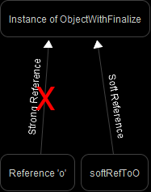
Soft References – Example No. 1

Slide 16
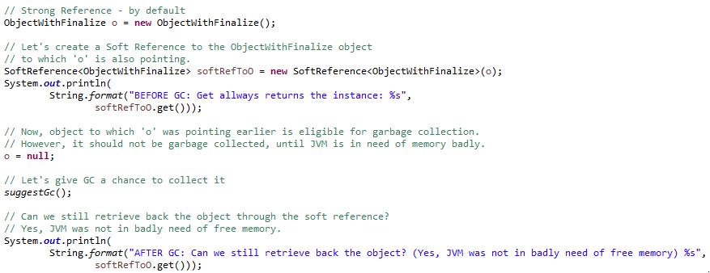
Soft References – Example No. 1
“get” returns this reference object's referent. If this reference object has been cleared, either by the program or by the garbage collector, then this method returns null.

Slide 17
Soft References – Example No. 1
BEFORE GC: Get allways returns the instance: other.references.SoftReferenceExample$ObjectWithFinalize@15db9742
Calling System.gc() and sleeping 1 second ...
Calling System.gc() and sleeping 1 second ...
Calling System.gc() and sleeping 1 second ...
AFTER GC: Can we still retrieve back the object? (Yes, JVM was not in badly need of free memory) other.references.SoftReferenceExample$ObjectWithFinalize@15db9742

Slide 18
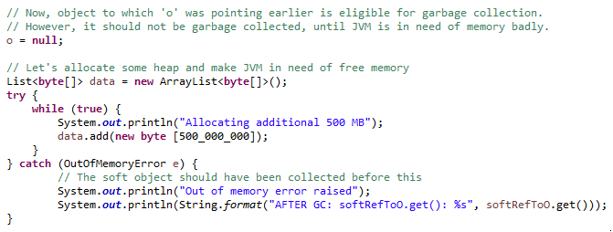
Soft References – Example No. 2

Slide 19
Soft References – Example No. 2
BEFORE GC: Get allways returns the instance: other.references.SoftReferenceExample2$ObjectWithFinalize@15db9742
Allocating additional 500 MB
Allocating additional 500 MB
Allocating additional 500 MB
Allocating additional 500 MB
Allocating additional 500 MB
Allocating additional 500 MB
Out of memory error raised
AFTER GC: softRefToO.get(): null
The object other.references.SoftReferenceExample2$ObjectWithFinalize@15db9742 is being finalized!

Slide 20
Phantom References
If the garbage collector determines at a certain point in time that the referent of a phantom reference is phantom reachable, then at that time or at some later time it will enqueue the reference.
To create such references java.lang.ref.PhantomReference and java.lang.ref.ReferenceQueue classes are used.
Example: new PhantomReference<T>(instance, referenceQueue);
In order to ensure that a reclaimable object remains so, the referent of a phantom reference may not be retrieved. The get method of a phantom reference always returns null.
Most often used for scheduling pre-mortem cleanup actions

Slide 21
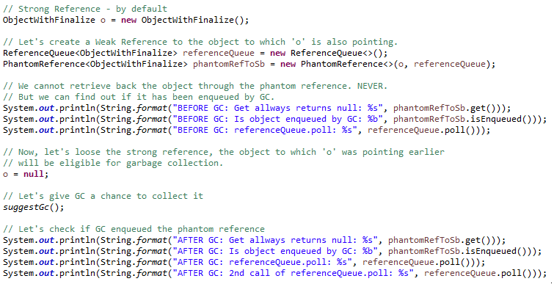
Phantom References – Example

Slide 22
Phantom References – Example
BEFORE GC: Get allways returns null: null
BEFORE GC: Is object enqueued by GC: false
BEFORE GC: referenceQueue.poll: null
Calling System.gc() and sleeping 1 second ...
The object other.references.PhantomReferenceExample$ObjectWithFinalize@49b04085 is being finalized!
Calling System.gc() and sleeping 1 second ...
Calling System.gc() and sleeping 1 second ...
AFTER GC: Get allways returns null: null
AFTER GC: Is object enqueued by GC: true
AFTER GC: referenceQueue.poll: java.lang.ref.PhantomReference@15db9742
AFTER GC: 2nd call of referenceQueue.poll: null

Slide 23
Phantom References – Example
QUESTION: If the “get” method of a phantom reference always returns null, no matter if we call it before or after GC, how can we find out what referent has been finalized and/or what pre-mortem cleanup action should we execute?

Slide 24
Phantom References – Example
QUESTION: If the “get” method of a phantom reference always returns null, no matter if we call it before or after GC, how can we find out what referent has been finalized and/or what pre-mortem cleanup action should we execute?
ANSWER: You can extend the “PhantomReference” class and remember some metadata.

Slide 25
java.util.WeakHashMap
Hash table based implementation of the Map interface, with weak keys.
An entry in a WeakHashMap will automatically be removed when its key is no longer in ordinary use.
When a key has been discarded its entry is effectively removed from the map, so this class behaves somewhat differently from other Map implementations.
Both null values and the null key are supported.

Slide 26
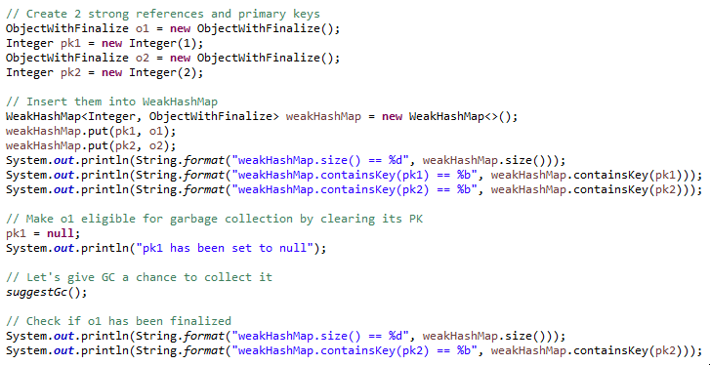
java.util.WeakHashMap

Slide 27
java.util.WeakHashMap
weakHashMap.size() == 2
weakHashMap.containsKey(pk1) == true
weakHashMap.containsKey(pk2) == true
pk1 has been set to null
Calling System.gc() and sleeping 1 second ...
Calling System.gc() and sleeping 1 second ...
Calling System.gc() and sleeping 1 second ...
weakHashMap.size() == 1
weakHashMap.containsKey(pk2) == true

Slide 28
Recap
What distinct forms of Java references do we know?

Slide 29
Recap
What distinct forms of Java references do we know?
Strong, Soft, Weak, Phantom

Slide 30
Recap
What distinct forms of Java references do we know?
Strong, Soft, Weak, Phantom
Which one is used in 99.99% cases?

Slide 31
Recap
What distinct forms of Java references do we know?
Strong, Soft, Weak, Phantom
Which one is used in 99.99% cases?
Strong

Slide 32
Recap
What distinct forms of Java references do we know?
Strong, Soft, Weak, Phantom
Which one is used in 99.99% cases?
Strong
Which one’s “get” method always returns null?

Slide 33
Recap
What distinct forms of Java references do we know?
Strong, Soft, Weak, Phantom
Which one is used in 99.99% cases?
Strong
Which one’s “get” method always returns null?
Phantom

Slide 34
Recap
What distinct forms of Java references do we know?
Strong, Soft, Weak, Phantom
Which one is used in 99.99% cases?
Strong
Which one’s “get” method always returns null?
Phantom
Which one asks GC to wait until there is not enough memory?

Slide 35
Recap
What distinct forms of Java references do we know?
Strong, Soft, Weak, Phantom
Which one is used in 99.99% cases?
Strong
Which one’s “get” method always returns null?
Phantom
Which one asks GC to wait until there is not enough memory?
Soft

Slide 36
Recap
What distinct forms of Java references do we know?
Strong, Soft, Weak, Phantom
Which one is used in 99.99% cases?
Strong
Which one’s “get” method always returns null?
Phantom
Which one asks GC to wait until there is not enough memory?
Soft
What needs PhantomReference in its constructor?

Slide 37
Recap
What distinct forms of Java references do we know?
Strong, Soft, Weak, Phantom
Which one is used in 99.99% cases?
Strong
Which one’s “get” method always returns null?
Phantom
Which one asks GC to wait until there is not enough memory?
Soft
What needs PhantomReference in its constructor?
instance, ReferenceQueue

Slide 38
Recap
What distinct forms of Java references do we know?
Strong, Soft, Weak, Phantom
Which one is used in 99.99% cases?
Strong
Which one’s “get” method always returns null?
Phantom
Which one asks GC to wait until there is not enough memory?
Soft
What needs PhantomReference in its constructor?
instance, ReferenceQueue
Hash table implementing the Map interface, with weak keys?

Slide 39
Recap
What distinct forms of Java references do we know?
Strong, Soft, Weak, Phantom
Which one is used in 99.99% cases?
Strong
Which one’s “get” method always returns null?
Phantom
Which one asks GC to wait until there is not enough memory?
Soft
What needs PhantomReference in its constructor?
instance, ReferenceQueue
Hash table implementing the Map interface, with weak keys?
WeakHashMap

Slide 40
Recap
How can we deal with lapsed listeners (observers)?

Slide 41
Recap
How can we deal with lapsed listeners (observers)?
Always unregister your listeners unless they are interested in receiving notifications.

Slide 42
Recap
How can we deal with lapsed listeners (observers)?
Always unregister your listeners unless they are interested in receiving notifications.
and/or
Check if observers are still active (push vs. pull)

Slide 43
Recap
How can we deal with lapsed listeners (observers)?
Always unregister your listeners unless they are interested in receiving notifications.
and/or
Check if observers are still active (push vs. pull)
and/or
Use weak references to keep track of registered observers.
Find an object that has the same lifecycle as the observers and hold a strong reference to the observer within it
Consider if you need to store observers in a thread-safe implementation of List

